Slide 1



Slide 2
PERSONALISED
MOVIE
RECOMMENDATIONS

Slide 3


imdb
Harnoor Kaur 102317138
Ridhi Gupta
102317139

Slide 4

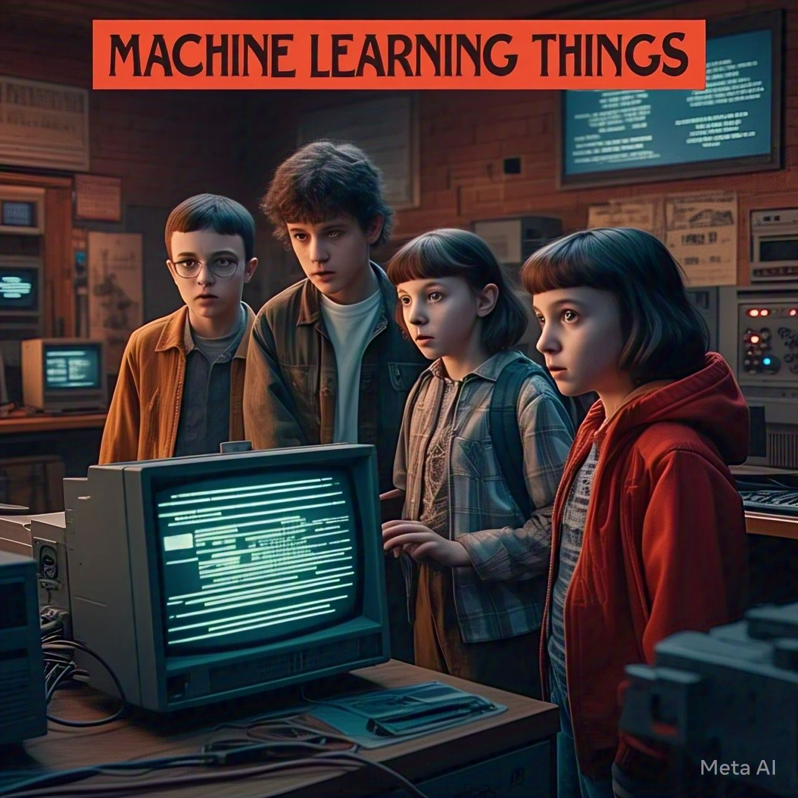
4
PROBLEM STATEMENT
Subtitle
INTRODUCTION
100% for you
18+
2025
Movie recommendation systems have become an essential part of online streaming platforms, helping users find content that matches their interests. The goal of this project is to build a movie recommendation system using machine learning techniques, based on similarity scores between movies. By leveraging a dataset containing movie metadata, we aim to provide personalized recommendations to users.
Next episode

Slide 5
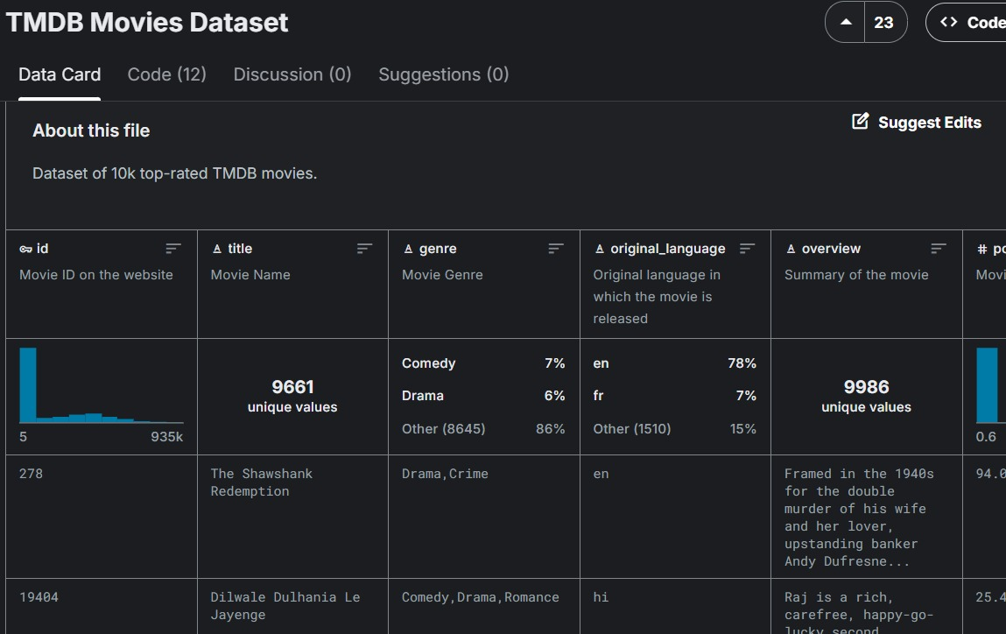
Dataset
The dataset used in this project is sourced from TMDB (The Movie Database) and consists of the following attributes:
● Movie Title: The name of the movie
● Genres: Categories assigned to the movie
● Popularity: A numerical score indicating the movie’s popularity
● Original Language: The primary language of the movie ● Movie ID: A unique identifier used for fetching posters from TMDb
● Other Metadata: Includes cast, crew, and overview details The dataset contains 10,000 movies, making it suitable for building a robust recommendation system.
Play

Slide 6





Libraries included
4
Pandas
Matplotlib
Scikit-learn
Streamlit
Requests
1 2 3 4 5

Slide 7
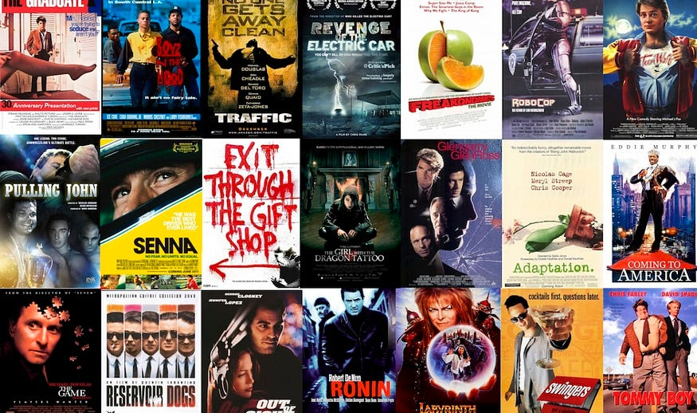
ML MODEL
CONTENT FILTERING
4
Subtitle
97% match
18+
2022
The idea behind Content-based (cognitive filtering) recommendation system is to recommend an item based on a comparison between the content of the items and a user profile. In simple words, I may get recommendation for a movie based on the description of other movies.
Play
+

Slide 8
4
ML MODEL IMPLEMENTATION
CountVector
Cosine
Similarity
Recomendation
function
Count Vectorizer from sklearn.feature_extraction.text is a feature extraction technique used in Natural Language Processing (NLP). It converts a collection of text documents into a bag-of-words (BoW) representation, where each word's frequency in a document is counted.
cosine similarity from sklearn.metrics.pairwise is a method used to measure the cosine of the angle between two non-zero vectors in a multi-dimensional space. It is commonly used in text similarity and recommendation systems.
This function recommends the top 5 similar movies based on a given movie title. It works by comparing similarity scores using a precomputed similarity matrix.

Slide 9
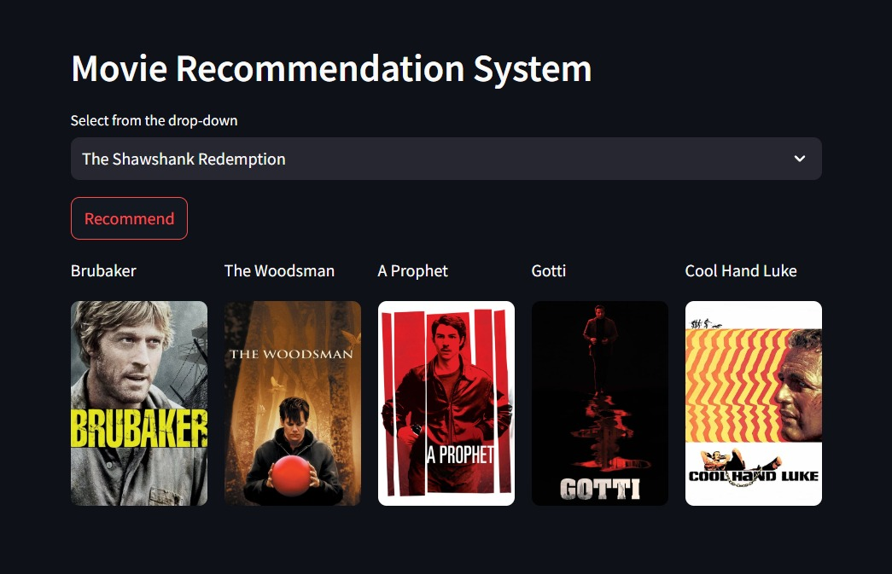
USER INTERFACE

Slide 10
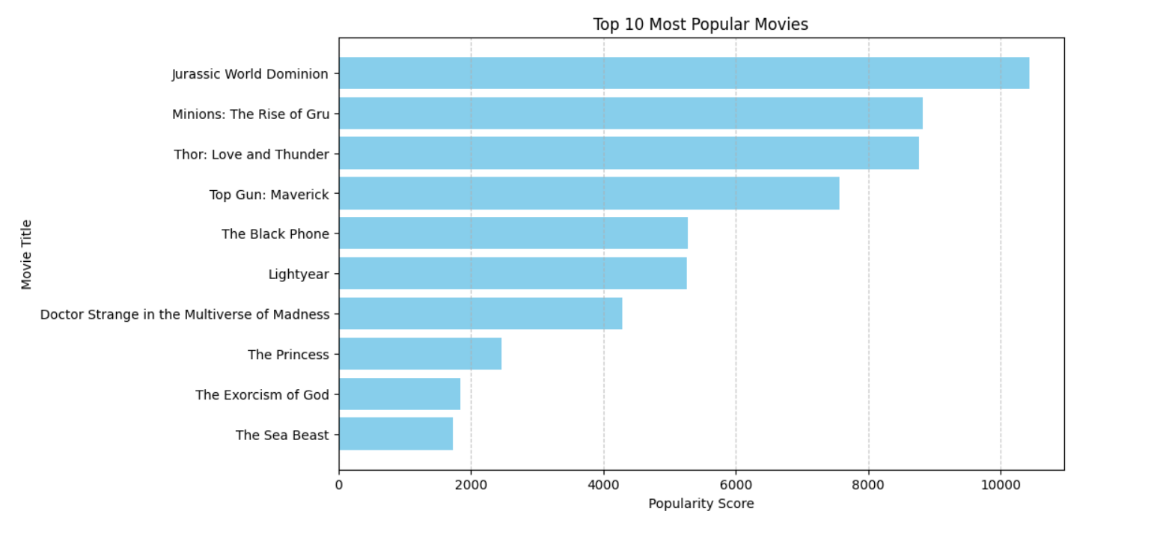
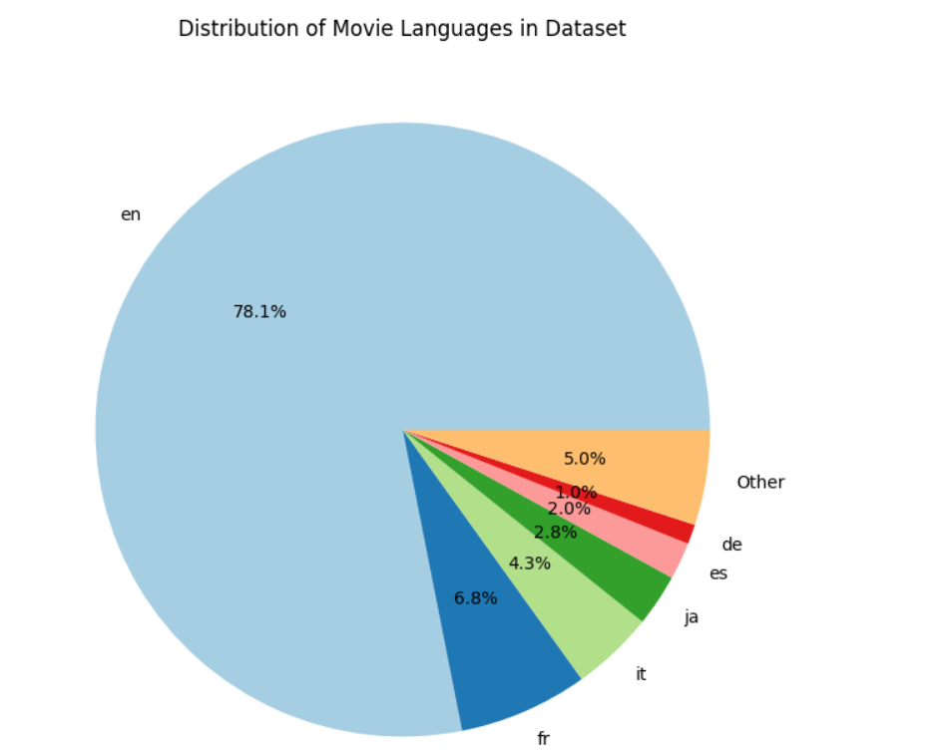
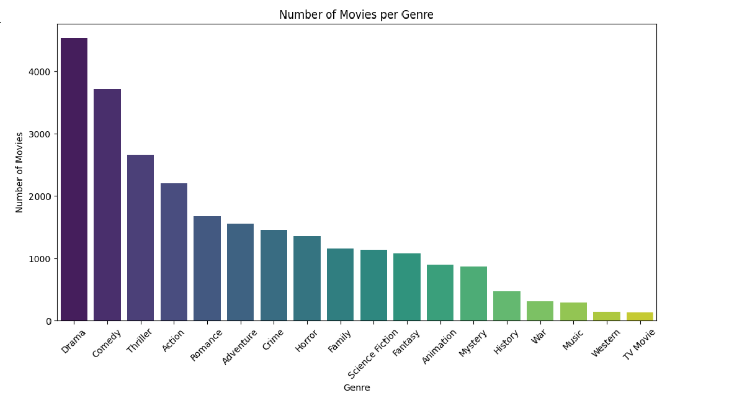
DATASET ANALYZATION
4
RESULTS AND
VISUALISATION
See More
My list

Slide 11
CHALLENGES AND
LEARNING
FUTURE OUTCOMES
Poster Retrieval Issues: Some movies lacked poster images in the TMDb database.
Data Cleaning: Handling missing or inconsistent movie metadata.
Recommendation Quality: Improving accuracy by incorporating additional features like user ratings and collaborative filtering.
Implementing hybrid recommendation techniques combining content-based and collaborative filtering.
Enhancing the user interface with search functionality and filters.
Integrating real-time user feedback to refine recommendations over time.

Slide 12
Studio
Production Company (distributor)
Production Company (producer)
Director (usually as “A ‘Director’ Film”)
FILM TITLE ML
Main Cast
Supporting Cast
Casting Director
Composer Costume Designer
Associate Producer(s)
Editor
Production Designer
Cinematographer
Executive Producer
Producer
Writer(s)
Director (Second reference)
Next

Slide 13
! PIP INSTALL
thanks

